Slide 1
UDI Benefits for Health Care – LUC Work Group

Slide 2
UDI Benefits for Health Care – LUC Work Group
UDI Benefits for Health Care Work Group
Hospital Supply Chain
Manufacturers
Suppliers and Distributors
Government
Patient Advocates
Five Sub Groups for Five Processes
Commodity Inventory co-leaders – Lena Cordie and Mike Nolan
Specialty Inventory leader – Ricki Wilson
EHR to Registry co-leaders – Joe Drozda and Sandi Michel
Adverse Events co-leaders – Madris Tomes and Mike Tanner
Product Recalls co-leaders – Jay Crowley and Pat Lupinetti

Slide 3
Project Overview
Current Process Flows for a Typical Hospital
Glossary
Assumptions
Current Process Flows for each process
Current challenges and points of UDI impact
Benefits and investments for HCOs
Health care Supply Chain and UDI Adoption
Future Process Flows for a Typical Hospital
Glossary
Assumptions
Future Process Flows for each process
Points of UDI Impact
Benefits
“Parking Lot” Summary and Next Steps

Slide 4
Current Process - Glossary
Health Care Organization: HCO
Electronic Health Record: EHR
An Electronic Health Record (EHR) is an electronic version of a patient’s medical history, that is maintained by the provider over time, and may include all of the key administrative clinical data relevant to that person’s care under a particular provider, including demographics, progress notes, problems, and medication.
Enterprise Resource Planning: ERP
Enterprise resource planning (ERP) is the integrated management of core business processes, often in real-time and mediated by software and technology. These business activities can include: product planning, purchase, production planning, manufacturing, or service delivery.
Electronic Data Interchange (EDI) Globally standardized transaction sets used for electronic business exchange.
Typical Health Care Organization (HCO): HCOs serving 80% of US population.
Medical device: All medical supplies meeting FDA Classification I, II, or III
EXCEPTIONS: biomedical equipment, software.

Slide 5
Future Process - Glossary
CIM – Clean Item Master (Future Entity) Item masters refreshed with UDI identifiers regularly updated by downloads from GUDID and overlaid with HCO pricing. Possible in future due to globally accessible unique device identifiers.
VIM – Virtual Item Master (Future Entity) A Clean Item Master (CIM) maintained by 3rd party entities for HCOs not maintaining their own. Function partially filled by business exchange organizations today (like GHX and First Databank).
3rd Party Submitters (Future Augmented Role) Agencies meeting FDA guidelines providing documentation for adverse events occurring in HCOs (like MedWatcher).
3rd Party Recall Management Organization (Future Augmented Role) Organizations providing timely recall information to HCOs (like ECRI and RASMAS).
HCO Medical Device Data Management Function (Future Entity) HCO Medical Device Data Management function that will assure device data quality entering the HCO from outside entities as well as device data moved within/between clinical and business HCO systems (like HCO Item Master Maintenance function today).

Slide 6
Current Process - Common Assumptions
Work Flow Represents Activities in a Typical HCO
HCO Has Implemented an Electronic Health Record (EHR) System-Wide
HCO has Implemented an ERP System
No Interface Exists Between EHR and ERP
HCO Has No Consistent Bar Code Scanning System for Use with Medical Devices
HCO Uses Limited EDI Transaction Sets with Fewer Than 20 Vendors

Slide 7
Future Process - Assumptions
HCO scanning of the UDI (both DI and PI).
HCO access to accurate and timely data from GUDID.
Interoperability between clinical and business systems within an HCO (including EHR and ERP systems).
HCO uses EDI for POs, Acknowledgement, Advanced Ship Notice (ASN) and Accounts Payable for 95% of business transactions involving medical devices.
Ongoing supplier and HCO commitment to system updates and training protocols.

Slide 8
Health Care Supply Chain and UDI Adoption: A Changed Landscape
Before UDI Adoption:
Product location drives product information
After UDI Adoption:
Product information drives product location

Slide 9
Health Care Supply Chain After UDI Adoption: Imagining Possible Scenarios
Internet of things: Now a global grid of uniquely identified and serialized things on their way to care providers and patients.
A.I.-bots act as network managers: Continuously monitor the grid and move supplies to meet flexing demand patterns. Occasionally the A.I.-Bots send a message a human has to investigate.
Factory demand is level loaded: Inventory levels in the grid are low. 3PL logistics sees short, full truck runs, and turnaround times at docks are like Nascar pit stops.
Researchers monitor EHRs: Looking for patterns in consumption to minimize patient risk. The occasional recall alerts clinicians and the inventory grid to insure immediate action.
Drug and implant manufacturers: Providing innovation needed for next-gen products. The lost-opportunity costs from non-realized R&D are invested into agile projects using the global teams.

Slide 10
Inventory Management
Definition:
Inventory management work flow outlines how commodity data and physical products are ordered and consumed in an HCO.
Players:
HCO Purchasing Department
Distributors
Manufacturers
HCO Materials Management
HCO Clinical Departments
Commodity - Mostly Class l and non-implantable Class ll. These devices are considered "routine" in hospitals and usually bought in large quantities.

Slide 11
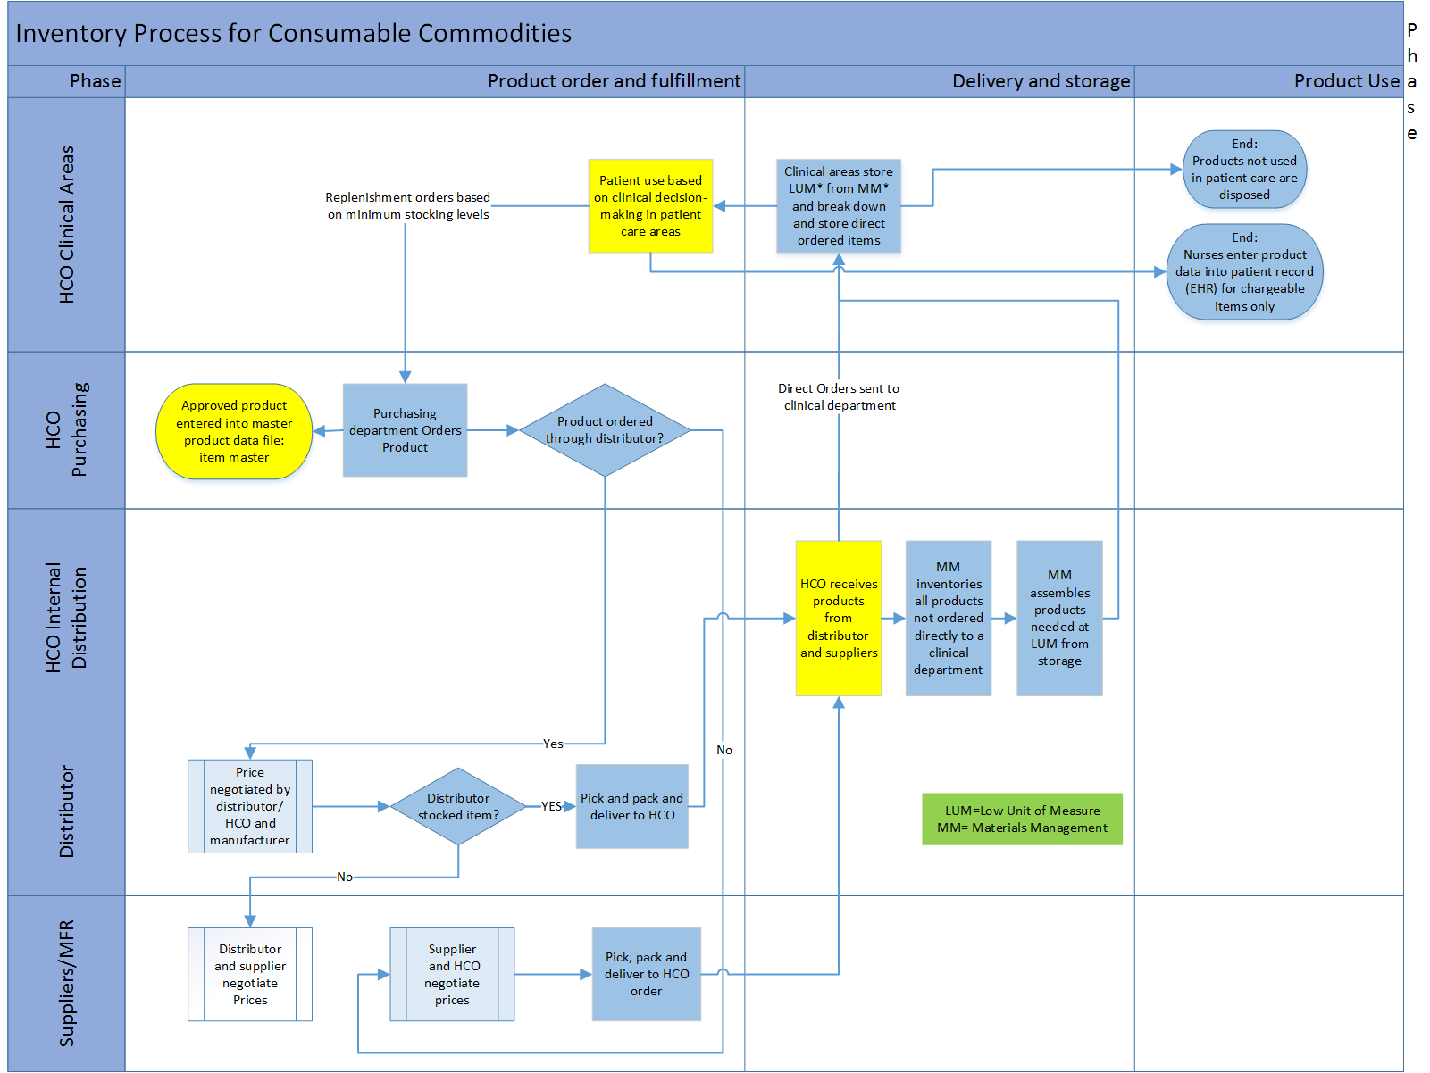

Slide 12
Challenges and UDI Impact Points Inventory Management
Challenges
HCO and supply partners use differing product identification schemes so orders and fulfillment are often inaccurate leading to excess inventory at many points along supply chain.
UDI Impact Points
Use GUDID to inform HCO master file and orders.
Scan production information (PI) during receiving.
Scan UDI into EHR at point of use.

Slide 13
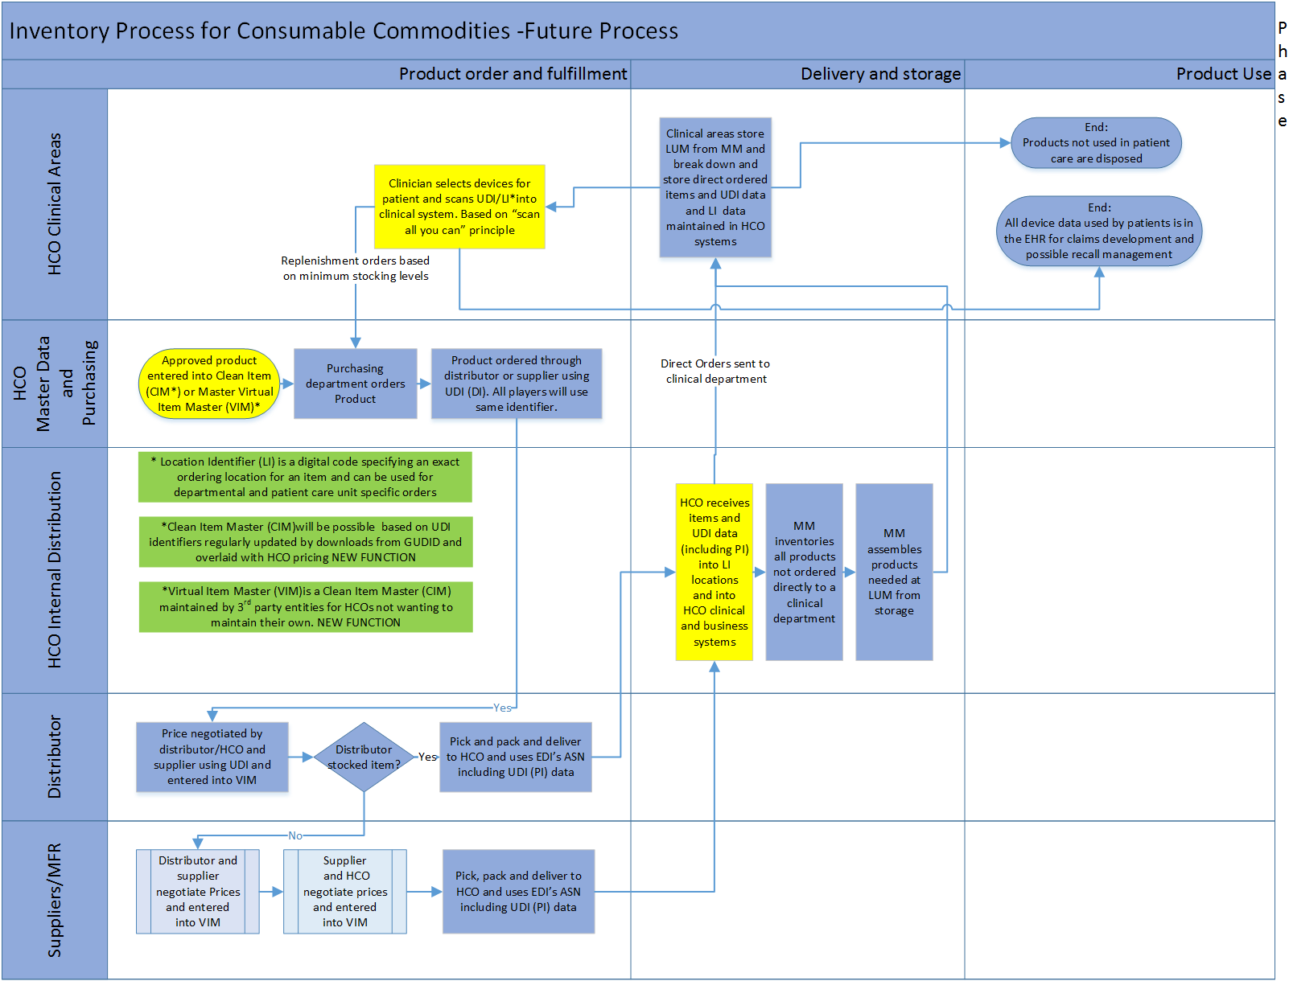

Slide 14
Inventory Management - Future Process
UDI Impact Points
CIM or VIM uses GUDID to inform HCO EDI purchase orders allowing standard product identification from Point of Use to manufacturing site. This clear electronic communication promotes manufacturing to fluctuate according to demand.
ASN scanning marries specific production information (PI) to device information (DI) in receiving process.
ERP to EHR interoperability brings complete UDI into HCO clinical systems available to match POU scanning.
Scanning brings UDI into EHR at point of use.

Slide 15
UDI Adoption – Inventory Management
Benefits
Savings – $40-100 billion in health care each year - $16.36 million per hospital per year plus $2.5 million one time inventory reduction.
Better outcomes – 50% reduction in medication error.
Safer supply chain – Reduced out of date or obsolete products.
Digital foundation – Higher quality data with increased visibility will lead to further health care improvement; mobile, personalized, collaborative.
Investments
Training – Develop best practices – Standards and AIDC technology.
Scanning hardware.
IT infrastructure – Integration or upgrades of MMS / ERP / EHR.
Cost per hospital – One time $1.2 million + $150,000 annual maintenance.
Net – Positive - $24 million in first six years.
https://www.gs1.org/docs/healthcare/McKinsey_Healthcare_Report_Strength_in_Unity.pdf
http://www.mckinsey.com/industries/healthcare-systems-and-services/our-insights/strengthening-health-cares-supply-chain-a-five-step-plan

Slide 16
Inventory Management Benefits of Future Process
Savings (McKinsey, 2013)
$40-100 billion in health care each year
$16.36 million per hospital per year plus
$2.5 million one time inventory reduction.
Labor - HCO item master maintenance/receiving process
Space - Smaller storage spaces all along supply chain
Costs - Reduced handling and inventory expenses for suppliers
Safety
HCO knowledge of products on site
HCO knowledge of products used by patients

Slide 17
Specialty Inventory – “Trunk” Stock
Definition:
Specialty Inventory Work Flow outlines how implants flow through an HCO. These items are only purchased when physician decides product is needed for a specific procedure. Initial identification of the item in the hospital most often occurs at point of use.
Players:
Patients
Physicians
Vendors
OR Materials
Specialty - Mostly Class lll and implantable Class ll. These devices are considered patient-specific and usually bought for a specific procedure.
Case Manager
Scheduling
Nursing Staff
OR Billing

Slide 18
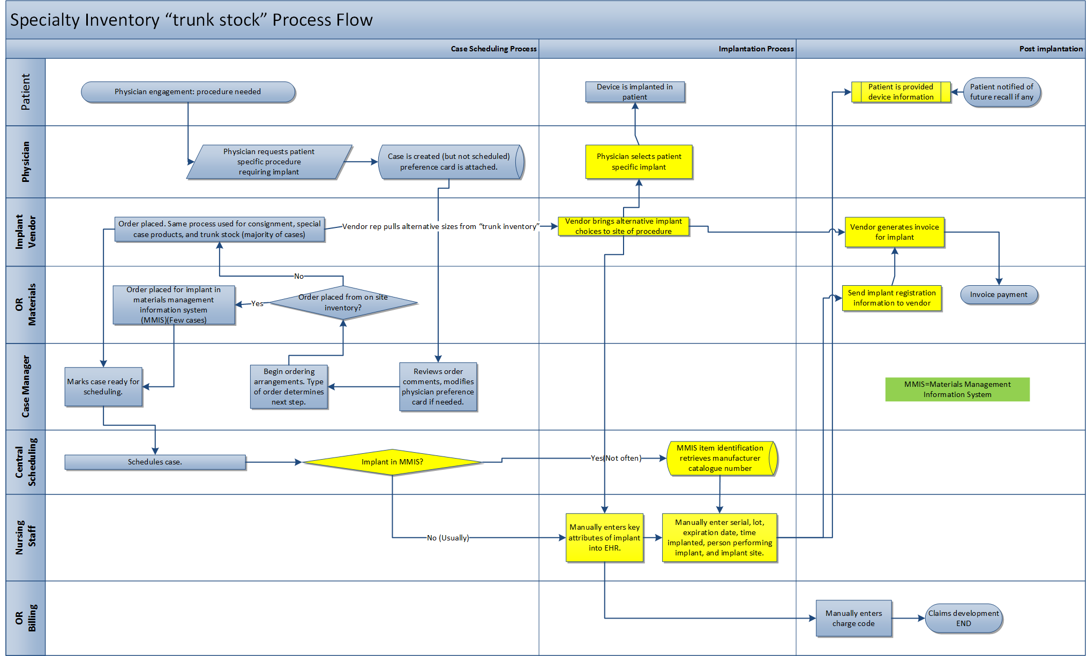

Slide 19
Challenges and UDI Impact Points Specialty Inventory
Challenges
HCO has low visibility into exact products used in procedure areas so cannot:
Capture all charges for products
Assess product risks
Respond well to product recalls
UDI Impact Points
Scan product at point of use.
Channel UDI information into ERP and EHR systems.
Hold UDI in EHR for potential recalls.

Slide 20
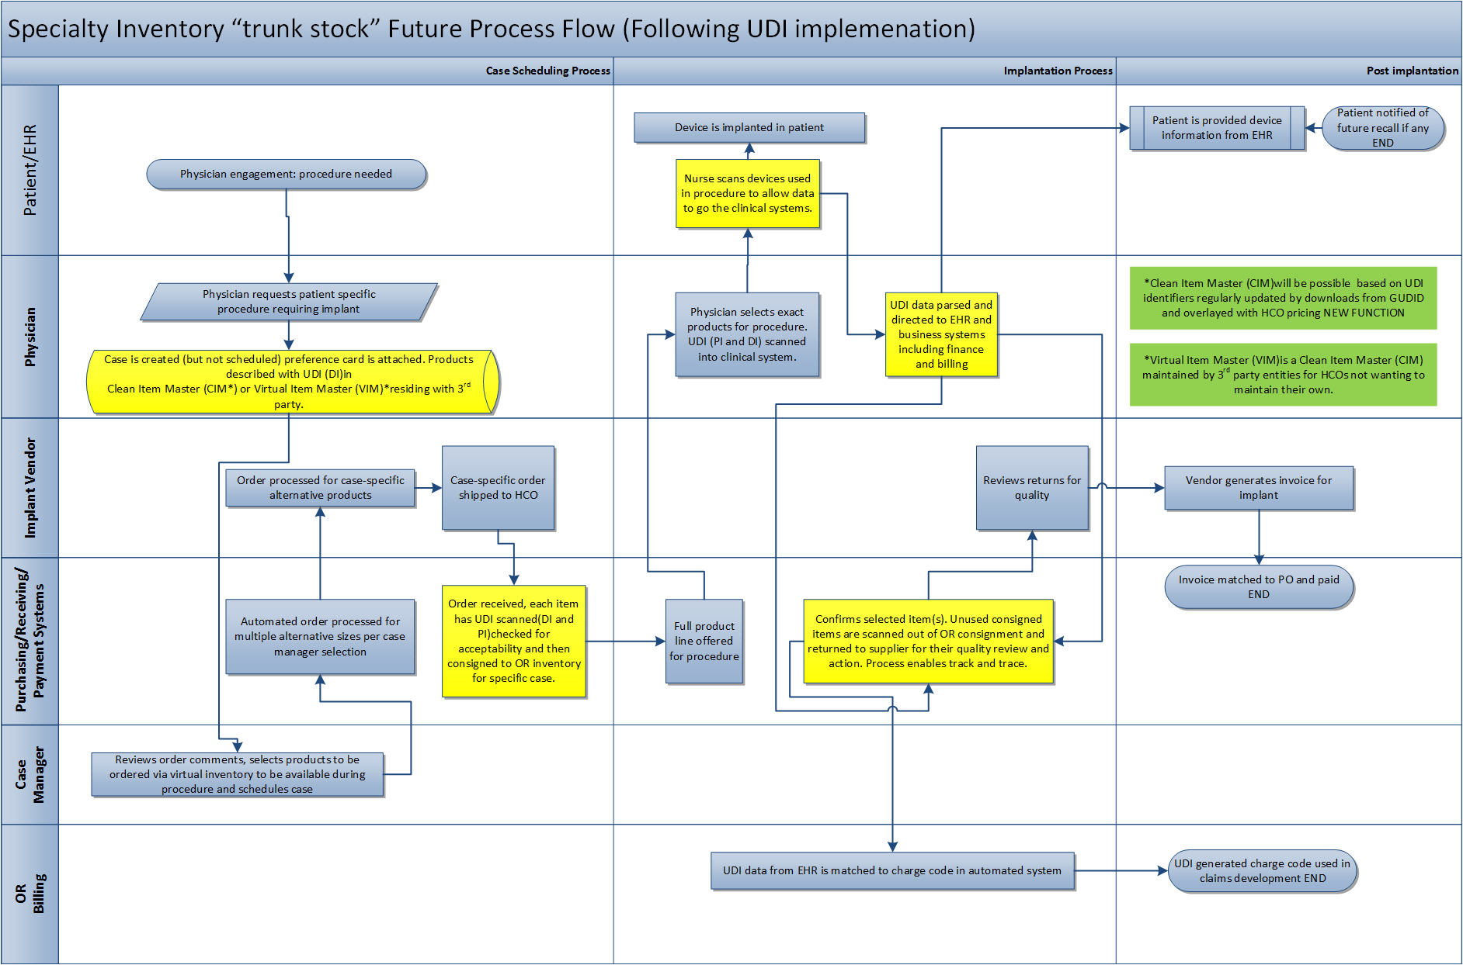

Slide 21
“Specialty” Inventory - Future Process
UDI Impact Points
HCO sends case-based order for “special” procedure.
Received case-based products received into HCO system (like all other orders).
Received product:
Opened but not used scanned as “waste”.
Used in procedure is scanned into EHR.
Not used in procedure or “wasted” is returned to supplier.
Invoiced by supplier and paid as for all other orders.
Supplier assisted cases remain as needed.

Slide 22
UDI Adoption – Specialty Inventory
Benefits
Scanning the UDI labeled device eliminates manual entry of device information into hospital system(s) and reduces manual entry errors.
Efficiencies in scanning device information may improve charge capture.
Connecting device information to patient via the EHR supports more effective communication of product recalls for devices implanted in that patient.
Investments
Bar code scanning solution at point of use.

Slide 23
“Specialty” Inventory Benefits of Future Process
Savings
Reduced inventory locations and materials handling for suppliers.
Reduced overall inventory held by suppliers.
Safety
HCO knowledge of all products on site permitting timely response to product recalls.
HCO knowledge of all products used by patients permitting timely response to product recalls.
Use of EHR Patient Communications allows appropriate recall information to be shared with patients.

Slide 24
EHR to Registry
Definition: The EHR to Registry Work Flow will demonstrate how product data currently moves from the site of care to the EHR and then to the product registry databases.
Players:
Cath Lab
Registry Staff
Physician
NCDR System

Slide 25
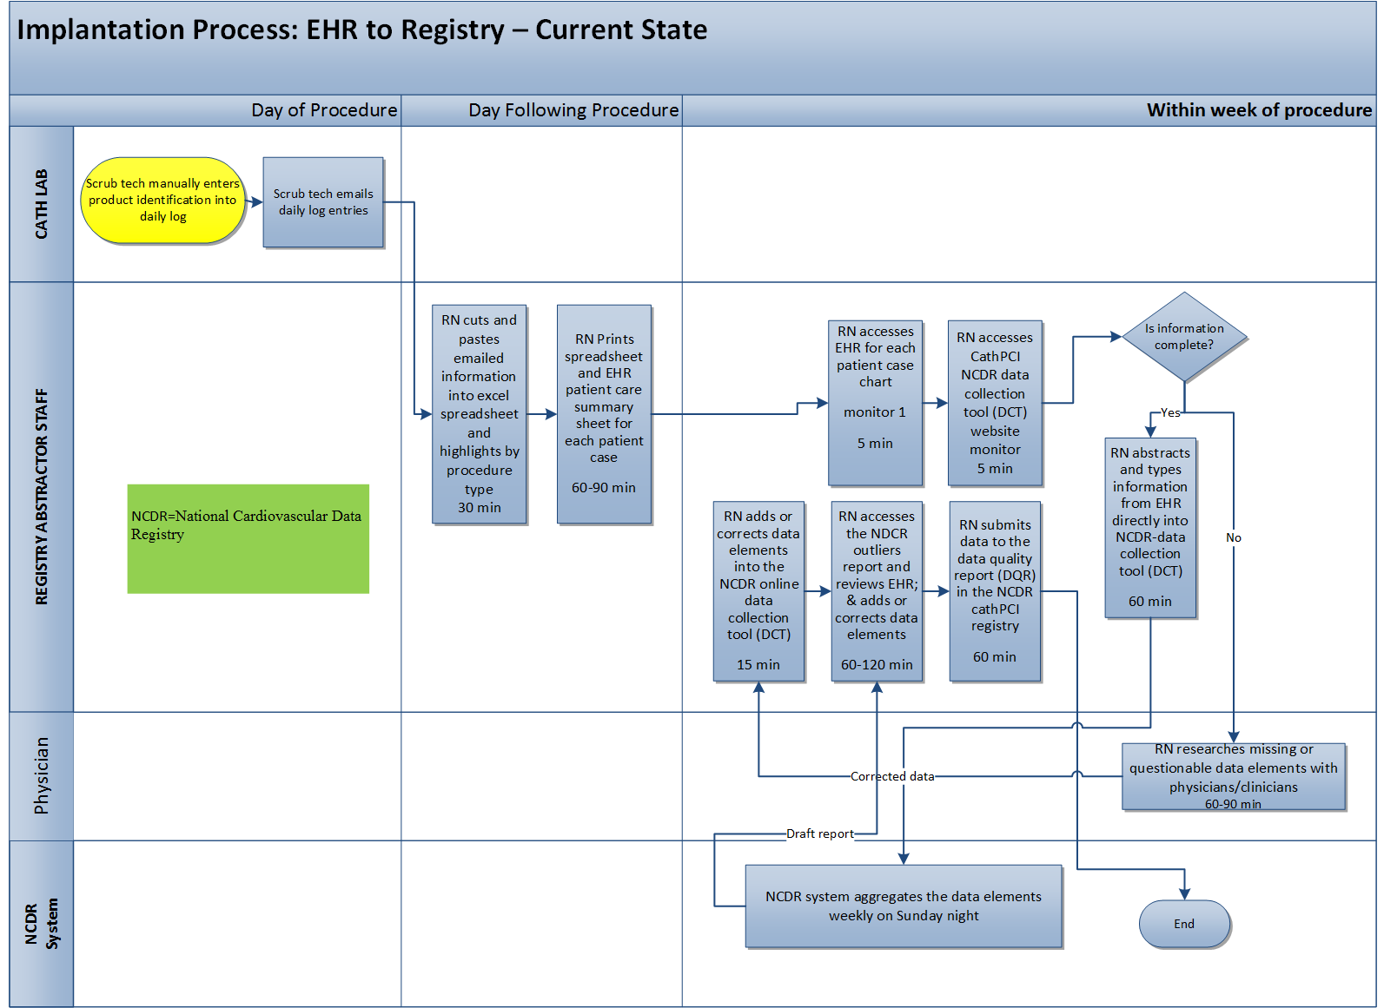

Slide 26
Challenges and UDI Impact Points EHR to Registry
Challenges
Manual data entry at site of care as well as into various registry records is error prone and very labor intensive for both HCOs and registries.
UDI Impact Points
Scan products at point of care.
Develop clinical system interoperability to pass UDI data to EHR and registries in lieu of manual entry.

Slide 27
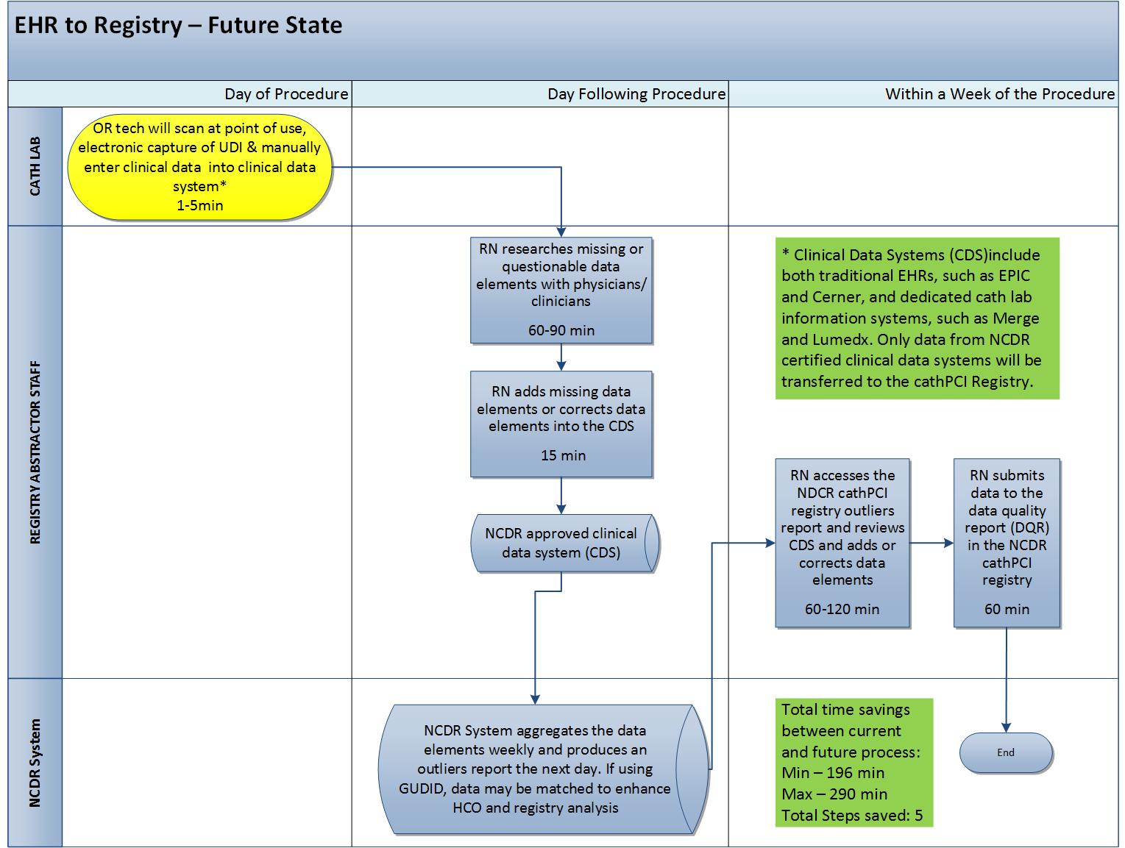

Slide 28
EHR to Registry - Future Process
UDI Impact Points
Scanned products at point of care and system interoperability permit UDI to inform all clinical systems and registries.
Scanning and interoperability saves five steps per case and about 200 minutes when compared to current process.
When registries use GUDID as the master file update source, data from HCO can be easily matched both to registry files as well as to other HCO data gathered by the registry permitting timely product evaluation and reporting.

Slide 29
UDI Adoption – EHR to Registry
Benefits
Replacing manual typing with scanned data fed from the EHR directly into the Registries eliminates errors and ensures required fields are completed.
Electronically feeding attributes from the GUDID into the registry ensures valuable analytics can be shared including cost, quality, and outcomes.
Electronic capture of specific data lessens the burden on clinicians and gives them more time with patients.
Investments
Invest in EHR software and scanners.

Slide 30
EHR to Registry Benefits of Future Process
Savings
Labor – about 200 minutes per case.
Safety
More accurate HCO reporting to registry.
Registry evaluation and reporting is timely and can be immediately integrated into HCO systems as “alerts” if necessary.

Slide 31
Adverse Events
Definition:
The Adverse Event Work Flow describes a malfunction, injury, or death event possibly resulting from the use of a device that may be reportable to the FDA and/or other agencies.
Players:
HCO Procedure Area
HCO Risk Management
Patient EHR
Supplier
FDA
CDC, CMS, State Health Boards
Assumption: Explants included

Slide 32
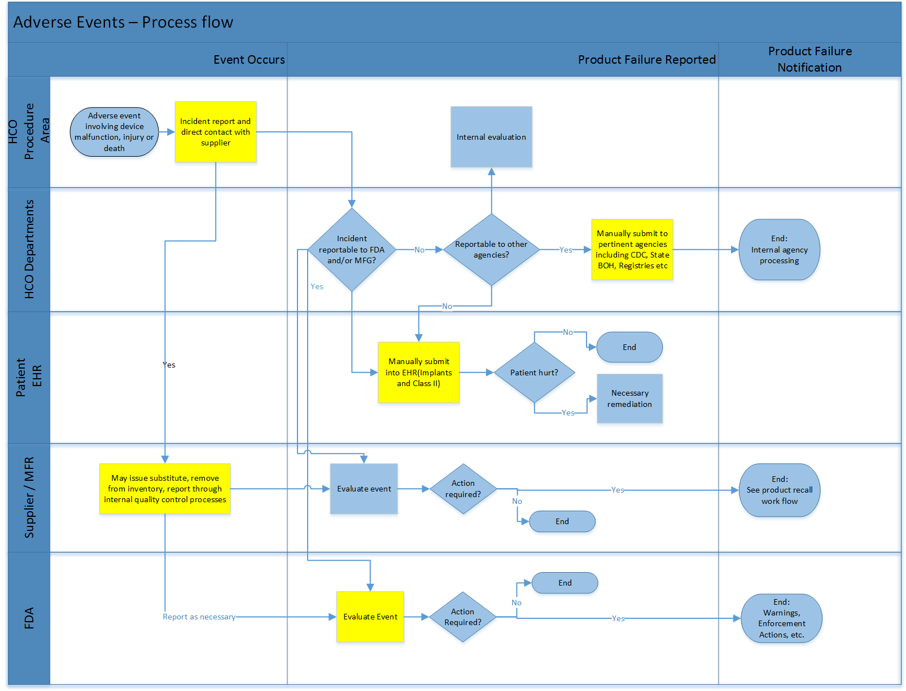

Slide 33
Challenges and UDI Impact Points Adverse Events
Challenges
Manual data entry into multiple HCO systems as well as to various outside agencies is labor intensive and error prone probably leading to underreporting of adverse events.
UDI Impact Points
Scan UDI at point of use with interface to HCO incident reporting system.
Move UDI adverse event data electronically to outside agencies and suppliers.

Slide 34
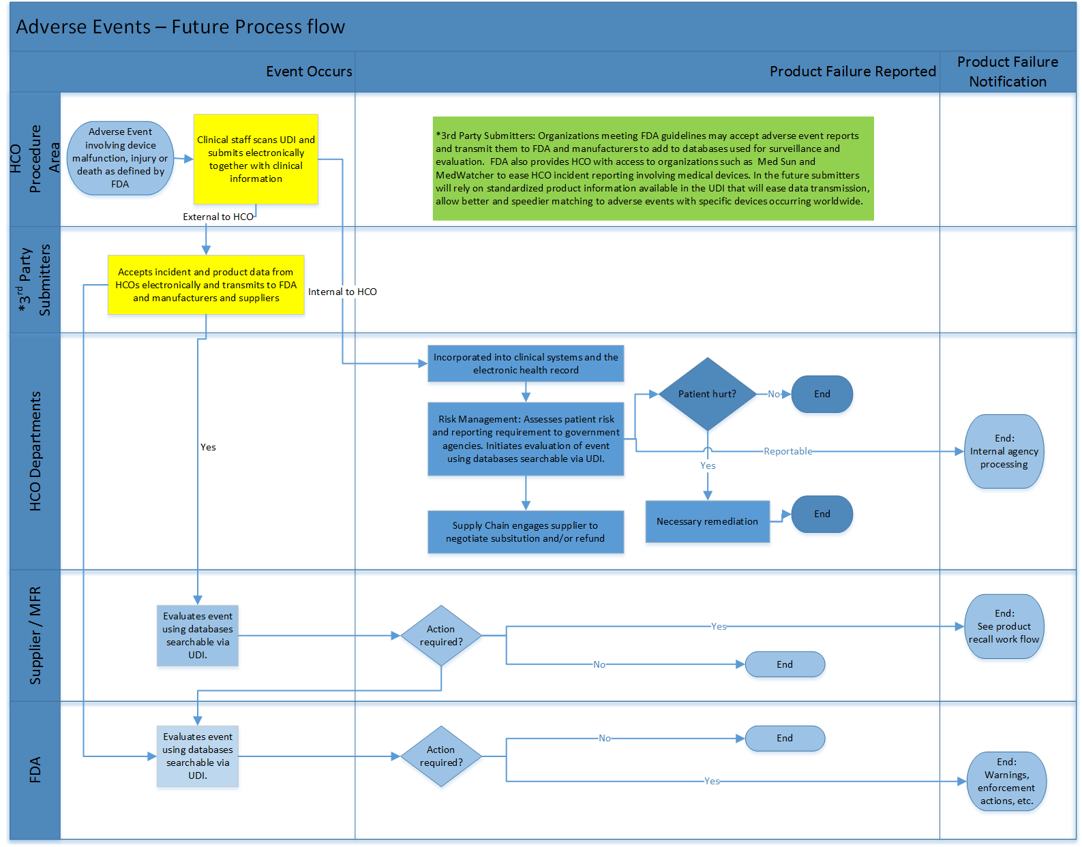

Slide 35
Adverse Events - Future Process
UDI Impact Points
Scan UDI at point of use with interface to HCO incident reporting system and 3rd party submitter.
3rd party submitter manages all communication between HCOs, suppliers, manufacturers, and FDA concerning adverse events involving medical devices.
HCO risk management and supply chain will have timely access to adverse event information and comparative product information in the long run.
HCO will pass event information to other government agencies as required using UDI.

Slide 36
UDI Adoption – Adverse Events
Benefits
UDI in the EHR, claim or incident reporting system provides reference for future events including explants and product recalls.
UDI on adverse event reports helps FDA (& Mfr) identify device issues that may track to the lot, batch, or even serial number level.
Malfunction that did not cause injury or death to a patient, but could in the future, should be sent to the FDA.
Investments
Scanners and scanning at point of use (if patient involved).
Incident reporting system and interface to EHR.

Slide 37
Adverse Events Benefits of Future Process
Savings
Labor savings for clinicians who currently report adverse events to many manufacturers and suppliers and will in future only report to a 3rd party submitter.
Electronic HCO communications to risk management and supply chain will reduce reporting time.
Safety
Manufacturers, suppliers, and FDA will get more timely and complete information from HCOs through 3rd party submitters and can respond accordingly.
Timely reporting will result in more timely recalls.
HCO risk management will have access to product evaluation information to assist with internal evaluation.

Slide 38
Product Recalls
Definition:
Product Recalls Work Flow outlines actions within an HCO that take place in response to notifications from distributors, manufacturers, 3rd party recall services, or the FDA stating that a medical device must be recalled.
Players:
FDA/Distributors/3rd party recall services/manufacturers
HCO Purchasing Department
HCO Clinical Departments
HCO Materials Management Department
Patients

Slide 39
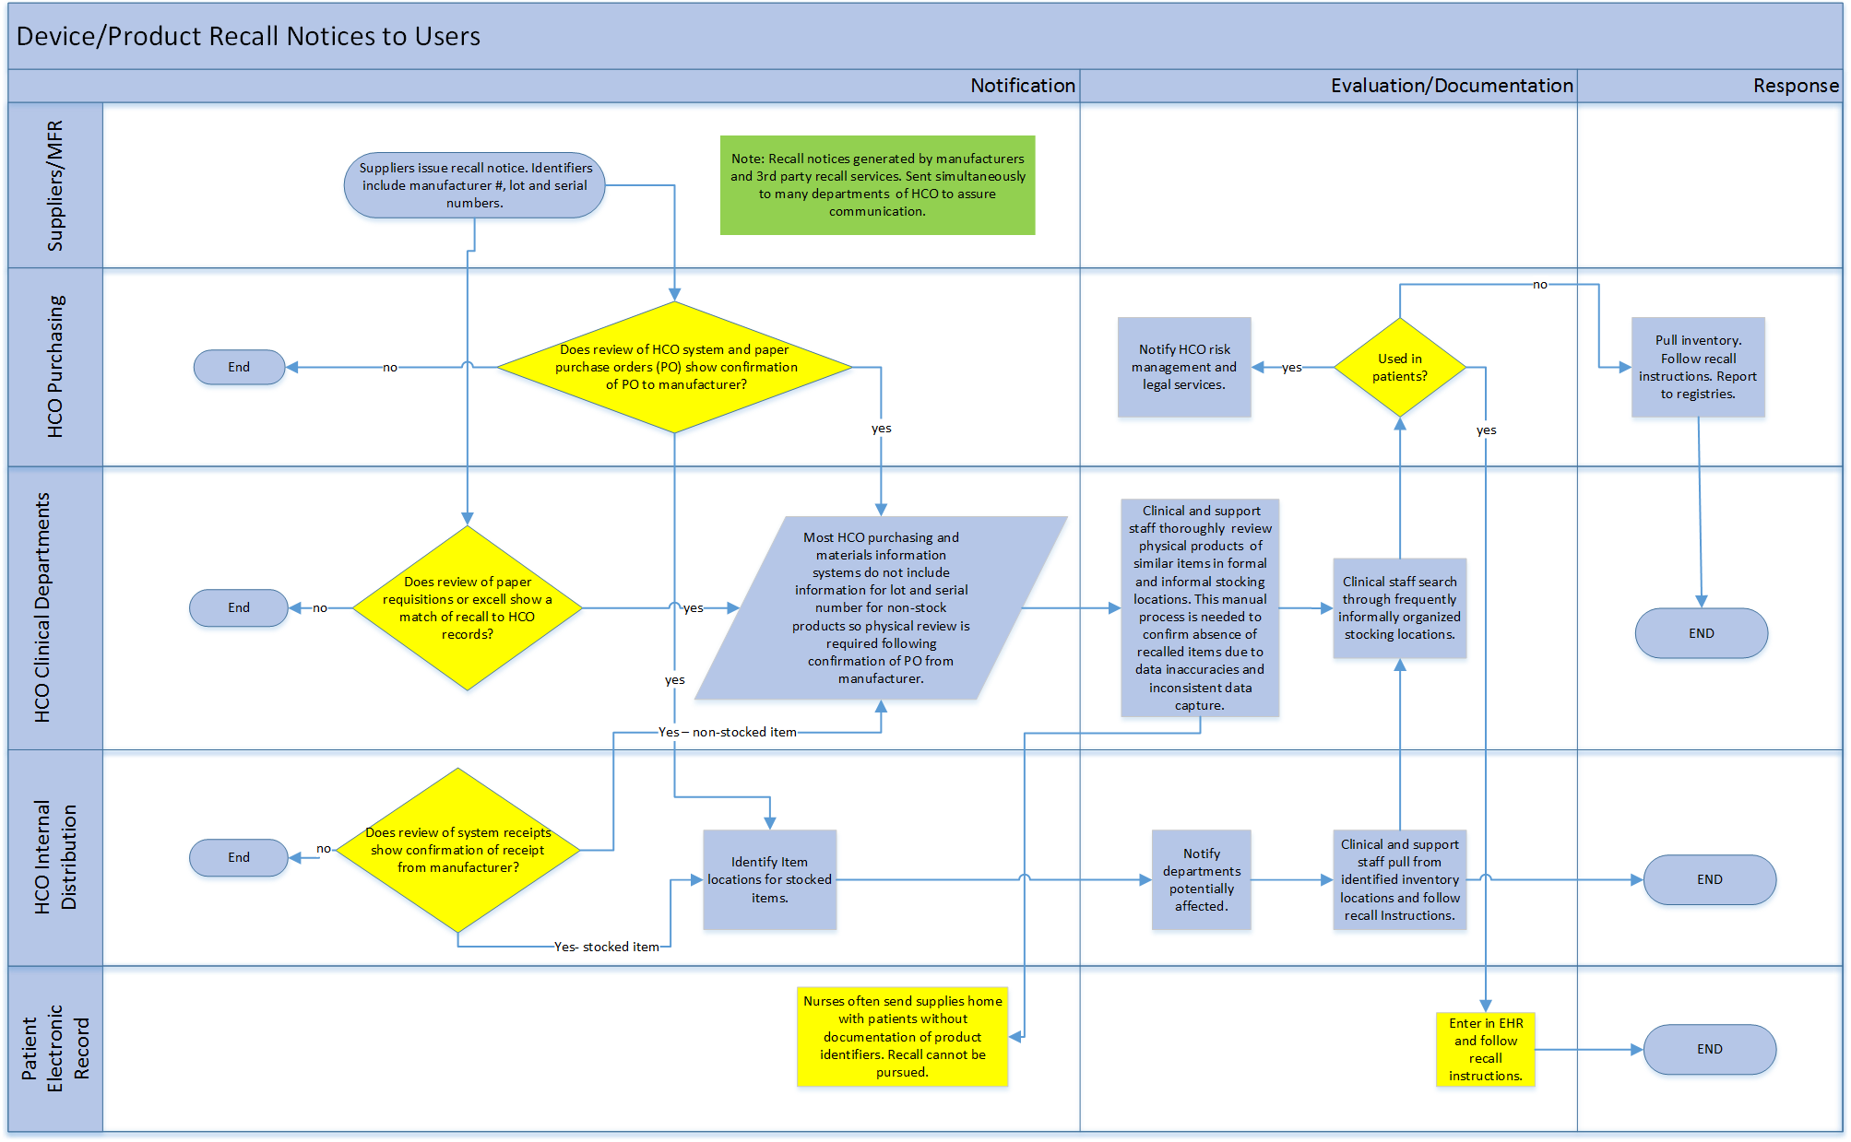

Slide 40
Challenges and UDI Impact Points Product Recalls
Challenges
Lack of master data file in HCO leads to suppliers and multiple HCO staff in many departments looking for recalled product without support in HCO systems. As a result, health care product recalls are relatively unsuccessful.
UDI Impact Points
Master data file used to inform hospital ERP and EHR on all devices purchased, held, and used with specific patients.

Slide 41
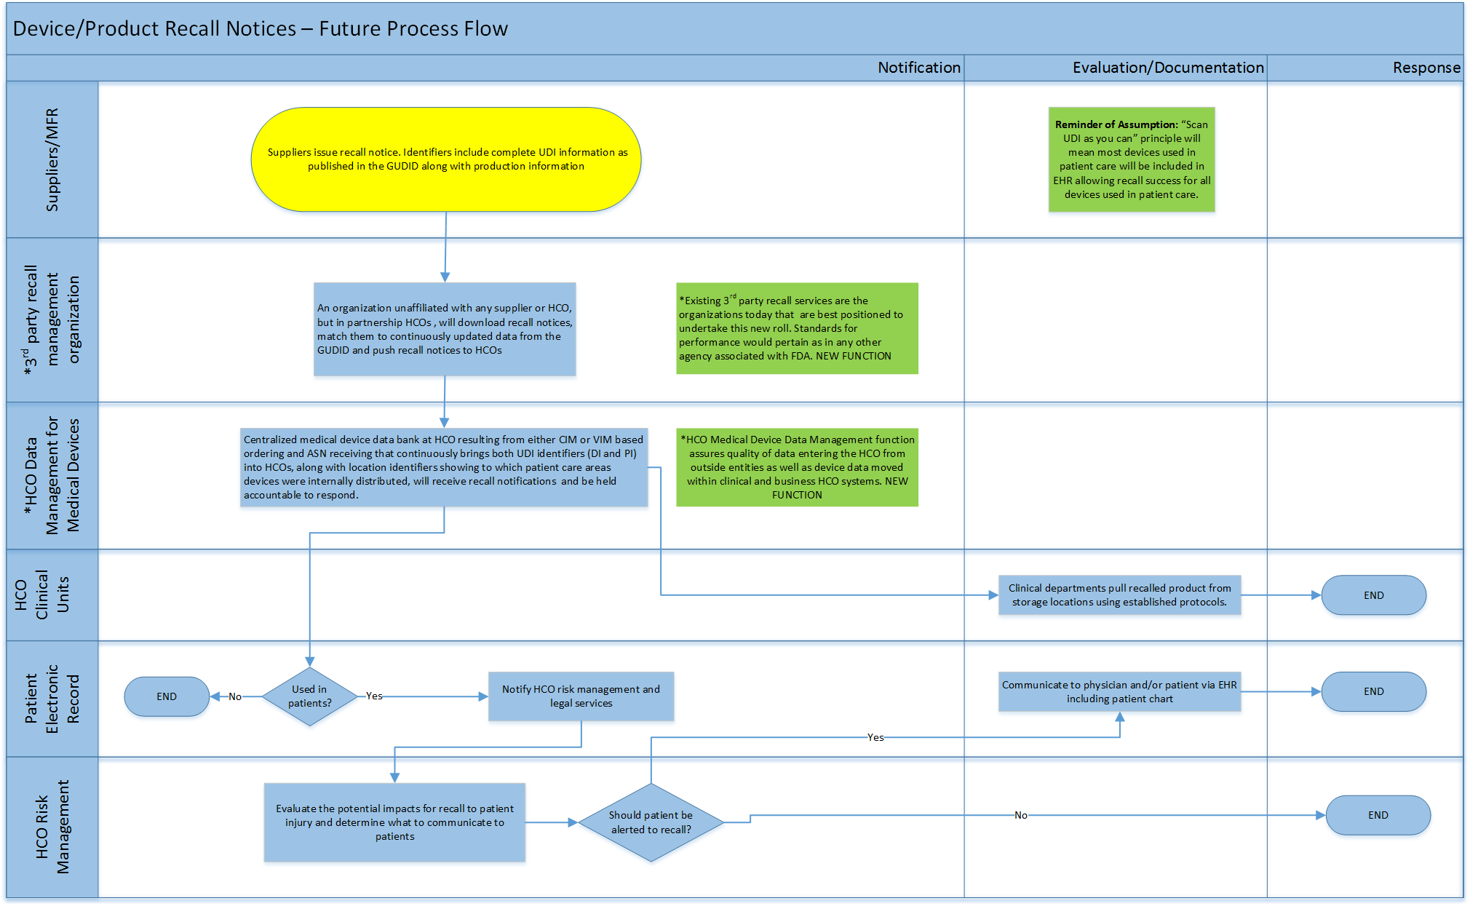

Slide 42
Product Recalls - Future Process
UDI Impact Points
Use of CIM or VIM together with ASN gives HCO specific knowledge of all products purchased to exact internal locations.
Interoperability of ERP to EHR gives HCO knowledge of all products used with patients.
3rd party recall management organization provides timely recall information that HCO can match to all internal product data.
HCO data management for medical devices is responsible to share internally to conduct recall.

Slide 43
UDI Adoption – Product Recalls
Benefits
Improves the ability to identify a specific recalled device within inventory management systems.
Documentation of device use in EHRs, reimbursement, and other clinical information system allows connection to specific patients.
Investments
Scanning capabilities at device acquisition and point of use/care.
Updates to EHRs, clinical information, and inventory management systems to capture device logistics/use.

Slide 44
Product Recalls Benefits of Future Process
Savings
Labor now used “hunting” for recalled product will decline as recalls will be focused specifically on known purchases to exact locations within an HCO. Savings two days per recall for a typical hospital. (McKinsey, 2012)
Patient Safety
Recalls along supply chain will be successful and recalled products will be unavailable to purchase and removed from all inventories.
Recalls found in EHR allow HCO patient communication to patient record as necessary.

Slide 45
Summary: Benefits and Investments of UDI Adoption
Benefits
Reduced manual data entry = labor savings
Improved data accuracy = better patient safety
Better charge capture in procedure areas = more revenue
Investments
Scanners
Scanning knowledge in IT
Master Data Management
ERP and EHR adjustments to accommodate UDI
System interoperability throughout HCO
EDI – Full implementation for commercial transactions

Slide 46
Summary
UDI will allow product information to replace current systems based upon physically viewing and handling products. Labor savings in HCOs will be comparable to grocery, retail, and manufacturing over the past 20 years.
Interoperability of business to clinical systems using UDI as the product identifier will promote broad-based timely research into product safety and effectiveness.

Slide 47
Call to Action
3rd Party software suppliers need to incorporate UDI and health system interoperability into future plans for upgrades.
Front-end supply management systems (such as Par Excellence, Omnicell, Space-Trax, etc.) need to incorporate UDI into all functions requiring product identification.

Slide 48
Parking Lot
Better Understanding of and Guidelines for:
Clean Item Master
Virtual Item Master
HCO Data Management for Medical Devices
Involve Registries to refine Definition of Future Process.
Develop current/future process for UDI and Equipment.
Involve HCO Risk Management to refine Adverse Events.
Better Understanding and Guidelines for Expanded Role:
3rd party submitters
3rd party recalls managers

Slide 49
Next Steps
Final narrative of ROI for UDI.
Development of an Executive Summary.
Development of educational materials for AHRMM to communicate to supply chain leaders.

